Slide 1

Note: The data and information in this document is reflective of a hypothetical situation and client. This document is to be used for KPMG Virtual Internship purposes only.
Sprocket Central Pty Ltd
Data analytics approach
Tania Syifa Utami

Slide 2
Note: The data and information in this document is reflective of a hypothetical situation and client. This document is to be used for KPMG Virtual Internship purposes only.
Agenda
Introduction
Data Exploration
Model Development
Interpretation

Slide 3
Note: The data and information in this document is reflective of a hypothetical situation and client. This document is to be used for KPMG Virtual Internship purposes only.
Introduction
Objective:
Identify high value customers based on demographic
Outline Problem:
Sprocket Central Pty Ltd is a company who specialises in high quality bikes and accessible cycling accessories for rides.
The marketing team want to boost their business based on existing customers
The marketing team want to know what type of customer that will bring value for company.
Data Analytics Approaches:
Profit earned by month
Age segmentation that has maximum profit
Order by product classes
Top industry contributing to sales
Profit and sales by state and wealth segment
Customer rank classification

Slide 4
Note: The data and information in this document is reflective of a hypothetical situation and client. This document is to be used for KPMG Virtual Internship purposes only.
Data Exploration
Data Quality Assessment
Data quality issues were identified:
 | Accuracy | Completeness | Consistency | Validaity | Relevancy
Customer Demographic | Innacurate DOB in one entry of customer | Several columns has missing values | Inconsistent format in gender column |  | - Irrelevant value in devalult column - DOB still less relevant
Customer Address |  |  | Inconsistency format in state columb
Transactions |  | Several column hs missing values |  | Wrong data type in product first sold date | Standard cost and list price still less relevant

Slide 5
Note: The data and information in this document is reflective of a hypothetical situation and client. This document is to be used for KPMG Virtual Internship purposes only.
Data Exploration
Data Quality Assessment
Data quality issues were solved:
 | Accuracy | Completeness | Consistency | Validaity | Relevancy
Customer Demographic | Change the inaccurate value of ODB | Implement dropping method and filling missing value | Change inconsistent format into standarized format |  | Drop default column Generate age and age category based on DOB
Customer Address |  |  | Change inconsistent format into standarized format
Transactions |  | Implement dropping method |  | Change product first sold date into datetime format | Generate profite based on standard cost and list price

Slide 6
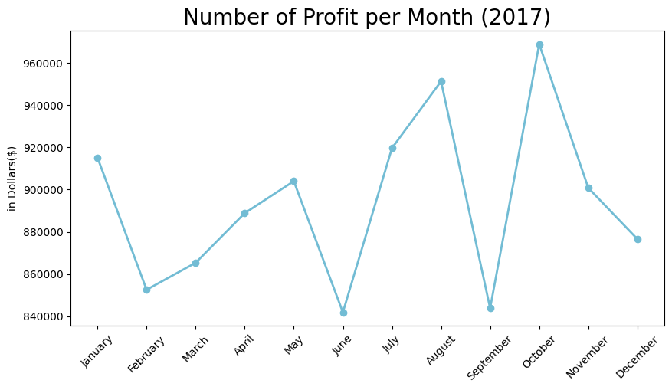
Note: The data and information in this document is reflective of a hypothetical situation and client. This document is to be used for KPMG Virtual Internship purposes only.
Model Development
Profit Earned by Month
In 2017, Sprocket Central Pty Ltd has highest profit in October at $968,986.41 and lowest in June at $841,815.26

Slide 7
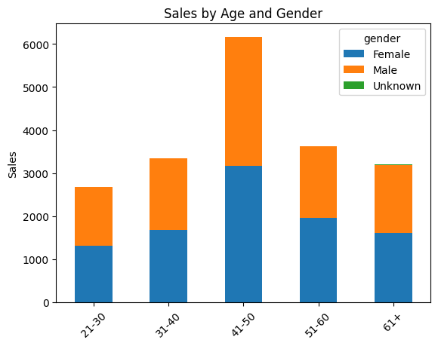
Note: The data and information in this document is reflective of a hypothetical situation and client. This document is to be used for KPMG Virtual Internship purposes only.
Model Development
Sales by Age Segmentation and Gender
For age segmentation, customers with age around 41-50 are the most contributed ones with total of 6,163 transactions during the year and also made up highest profit at $3,372,930.67
Female and male has almost same proportions for each of age group. Therefore, both should always be the main focus.

Slide 8
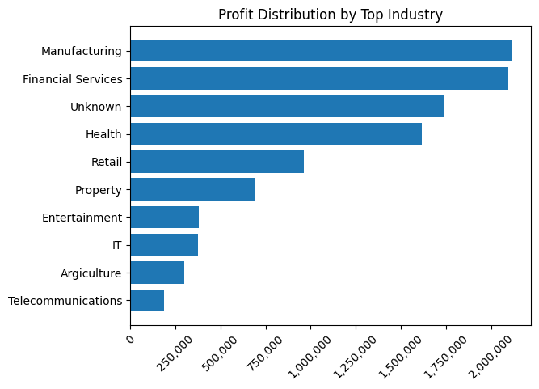
Note: The data and information in this document is reflective of a hypothetical situation and client. This document is to be used for KPMG Virtual Internship purposes only.
Model Development
Top Industry Comes Up from Customer's Background
Manufacturing, Financial Services, and Health are the most profitable sectors. [search why manufactring, finances services and health prefer bikes)

Slide 9
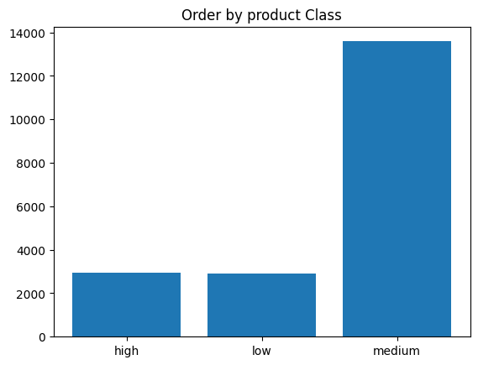
Note: The data and information in this document is reflective of a hypothetical situation and client. This document is to be used for KPMG Virtual Internship purposes only.
Model Development
Order by Product Classes
Medium-class product has enormous orders with total 13587 orders and comes up with highest profit at $845,8645.06. This indicates customers highly prefers medium class products
The number of orders for low-class product reaches 2096 orders, indicating customers still has interest in affordable products
Although being the lowest demand, customers are still willing to purchase high-class product. It shows these type of customers are drawn to the quality rather than price

Slide 10
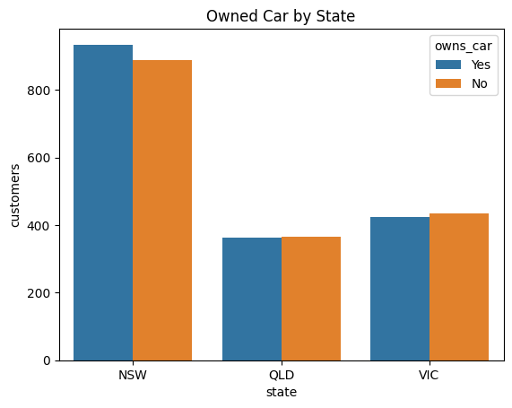
Note: The data and information in this document is reflective of a hypothetical situation and client. This document is to be used for KPMG Virtual Internship purposes only.
Model Development
Car Ownership Distribution by State
NSW is the main market as the number of customers without cars are the highest amongst the state.
QLD and VIC becomes potential markets for company for the customers who does not have a car.
Customers with car ownership still counted as potential market. It indicates the economic value for bikes as transportation still valueable

Slide 11
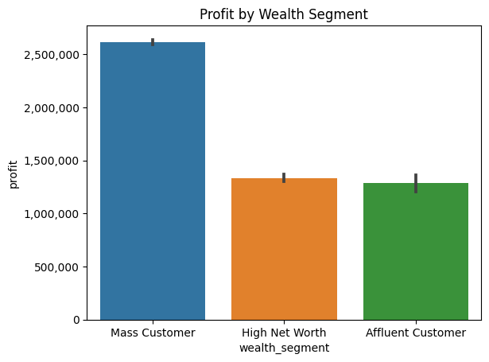
Note: The data and information in this document is reflective of a hypothetical situation and client. This document is to be used for KPMG Virtual Internship purposes only.
Model Development
Profit by Wealth Segment and Car Ownership
Mass Customers provides the highest profit for company at $5,227,503.47, followed by High Net Worth customers at $2,669,697.30 and Affluent Customers at $2,567,813.04.

Slide 12
Note: The data and information in this document is reflective of a hypothetical situation and client. This document is to be used for KPMG Virtual Internship purposes only.
Model Development
RFM Analysis
RFM Analysis (Recency, Frequency, and Monetary) is used to analyzing customer value.
Recency – How recently did the customer purchase?
Frequency – How often do they purchase?
Monetary – how much do they spend in total?

Slide 13
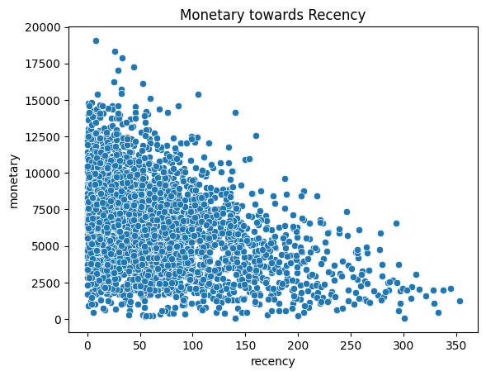
Note: The data and information in this document is reflective of a hypothetical situation and client. This document is to be used for KPMG Virtual Internship purposes only.
Model Development
RFM Analysis
(Monetary towards Recency)
Customers who have made more recenty purchase tend to have higher monetary
Customers located in top left quadrant, representing high recency and high monetary value. They have made recent purchases and spent siginificant amount of money. Tipically high value and active customers

Slide 14
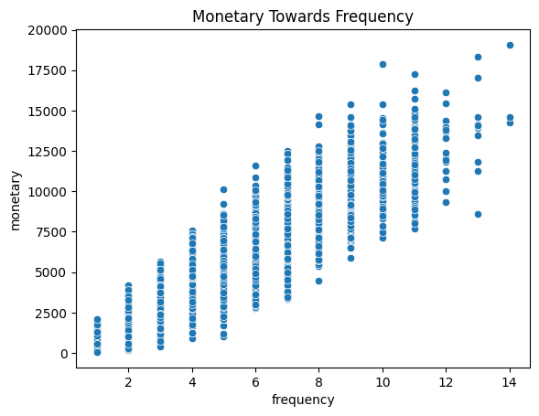
Note: The data and information in this document is reflective of a hypothetical situation and client. This document is to be used for KPMG Virtual Internship purposes only.
Model Development
RFM Analysis
(Monetary towards Frequency)
Customers who have made more frequent purchase tend to have higher monetary
Customers located in top right quadrant, representing high frequency and high monetary value. They have made frequent purchases and spent siginificant amount of money. These customers are most loyal and valuable segment
Customers located in center quadrant representing average frequency and monetary. May present opportunities for upsaelling or cross selling

Slide 15
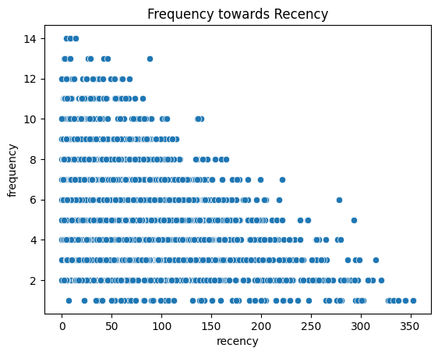
Note: The data and information in this document is reflective of a hypothetical situation and client. This document is to be used for KPMG Virtual Internship purposes only.
Model Development
RFM Analysis
(Frequency towards Recency)
Customers who have made more recency purchase tend to have higher frequency. Considered as active and engage customers
Customers located in bottom left quadrant, representing low frequency and high recency value. They have made low purchases but pruchase recently. These customers are potential market to increase their engagement

Slide 16
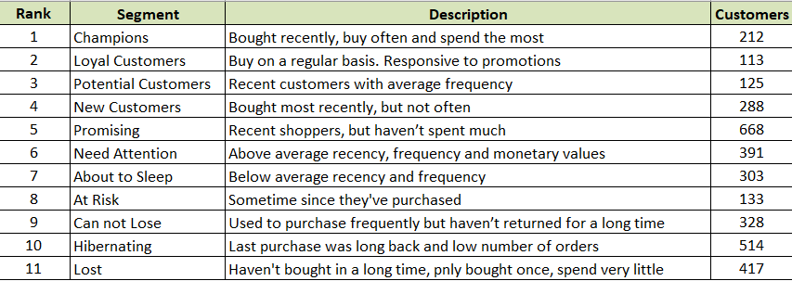
Note: The data and information in this document is reflective of a hypothetical situation and client. This document is to be used for KPMG Virtual Internship purposes only.
Model Development
Customers Segmentation based on RFM Value

Slide 17
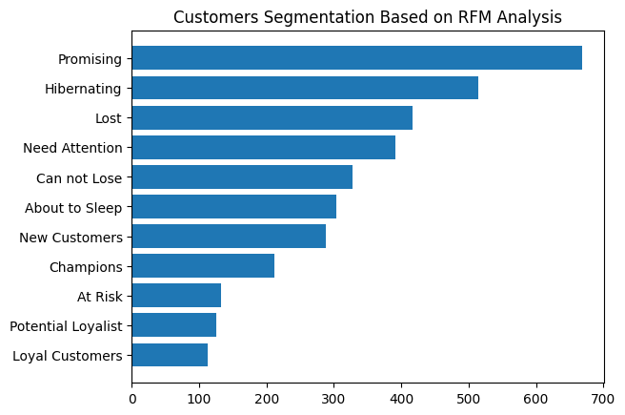
Note: The data and information in this document is reflective of a hypothetical situation and client. This document is to be used for KPMG Virtual Internship purposes only.
Interpretation
Customers Segmentation based on RFM Value
For existing customers, company can focus on maintaining type of customers which classified as champions, loyal customers, and potential loyalist
New customers and promising ones, have high opportunities for upselling or cross selling
Need attention type of customers can nurtured by encouraging them to increase their engagement

Slide 18
Note: The data and information in this document is reflective of a hypothetical situation and client. This document is to be used for KPMG Virtual Internship purposes only.
Interpretation
Potential High Value Customers in New Customers Dataset
Wealth segment:
Mass customers
By Age:
41-50
Class product:
Medium
Top 3 Industries:
Manufacturing, financial services, health
Potential Customers
Female & Male
Customers without car ownership
By State
NSW & VIC

Slide 19
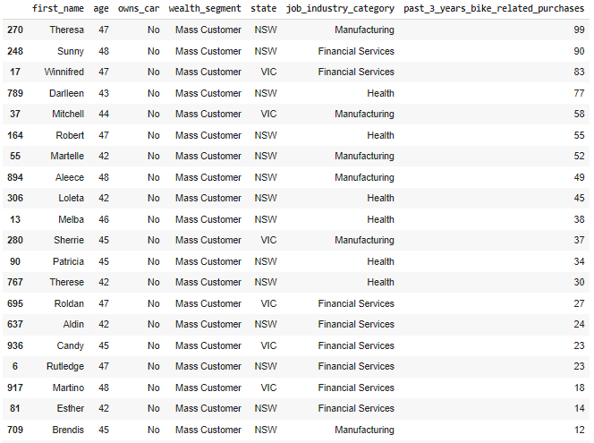
Note: The data and information in this document is reflective of a hypothetical situation and client. This document is to be used for KPMG Virtual Internship purposes only.
Interpretation
List of Top 20 New Customers with Potential High Value

